Slide 1
CITY HEIGHTS
STUDENT HOUSING
N. FOURTH STREET & ST. JOHN STREET,
SAN JOSE,CA
14639 Big Basin Wy, Saratoga, CA 95070
Brad Lee (408)785-2208
brad@redwoodres.com
Rev 2025-03-21

Slide 2
TABLE OF CONTENTS
I. PROJECT SITE
II. DEMOGRAPHIC
III. JOB OPPORTUNITY
IV. PROJECT DEVELOPMENT
A. INCOME ANALYSIS
B. CONSTRUCTION ANALYSIS
C. MARKET COMPARISON
V. RENT COMPARABLE

Slide 3
EXECUTIVE SUMMARY
• Assessor's Parcel Number | 467-20-019,020,021,040
• Project Address | 100-152 N. Fourth Street
• Proposed Use | Mixed-Use Retail & Multi-Family Student Preferred
• Gross Site Area | +/-0.98 ac
• Proposed Site Coverage Buildings Private Circulation Landscape/Hardscape | +/- 35,258 sf (82%) +/-486 sf (1%) +/-7,026 sf (17%)
• Proposed F.A.R. | 15.18; 649,197 sf
• Proposed Density | 298 Du / 0.98 Ac =304 Du/Ac
• Proposed Unit Mix | 135 Two Bedroom-Two Bath 95 Three Bedroom-Three Bath 68 Four Bedroom-Four Bath
• Proposed Height | 23 stories 250 to Top of Architectural Features
• Proposed Parking | 287 Cars(0.96 Car/Du) 426 Bicycles(0.43 Bicycles/Du)
• Proposed Common Open Space | 73 sf/Du
Site Development Permit to allow for the construction of a 23-story building (with a maximum height of 250 feet) containing up to 298 residential units and up to 8,423 sf of retail on a +/-0.98 acre site in the Downtown area. Permit will also allow for the relocation of two single-family homes on 145 & 152 N. 4th Street and the removal of 7 trees (6 ordinance-sized)

Slide 4
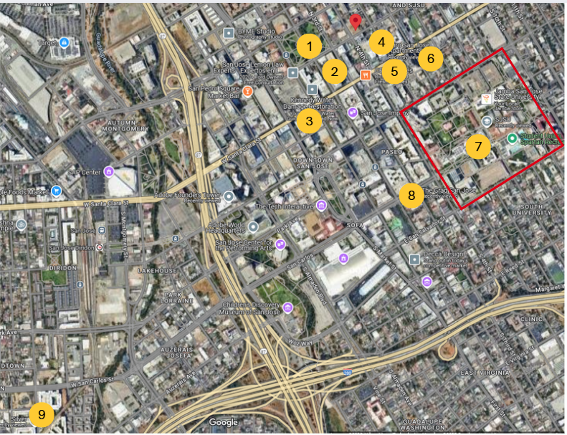
PROJECT SITE
100 N. FOURTH STREET & ST. JOHN STREET
100 N. 4th street, San Jose, a nearly 1 Acre rectangle site in the heart of Silicon Valley, a global tech hub home to companies like Apple, Google, and Nvidia. With the population of 1,013,240, it is also the 10th largest city in the United States. Known for its innovation and thriving startup ecosystem, it attracts top talent and investment. The city offers a diverse culture, excellent education, and a high quality of life. With its strategic location and strong business environment, San Jose continues to lead in technology, making it a key player in shaping the future of global development and innovation.
AERIAL OVERVIEW
1. Saint James Park | 4. Miro Apartment | 7. San Jose States University
2. Northeastern University in Silicon Valley | 5. City Hall | 8. The Graduate Apartment
3. Santa Clara Station | 6. Grocery Outlet | 9. Silver Apartment

Slide 5
INCOME ANALYSIS
Assumptions
Occupancy at 95%
Tenants pay for electricity and water; Landlord covers common area expenses.
House insurance costs are low due to fireproof construction.

Slide 6
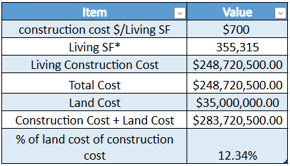
CONSTRUCTION ANALYSIS
Best Estimate of value cost analysis Construction Cost Estimate
*number of unit x unit size(SF)

Slide 7
Facebook
THE HEART OF
SILICON VALLEY
Google
AMD
Intel
Cisco
Nvidia
PayPal
Adobe
San Jose State University

Slide 8
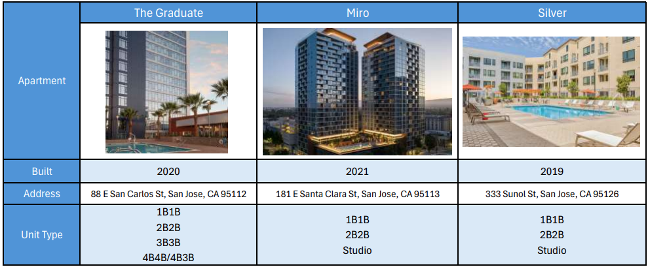
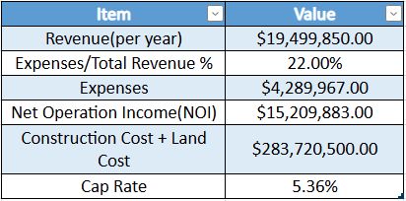
MARKET COMPARISON
>
4
Average market %

Slide 9
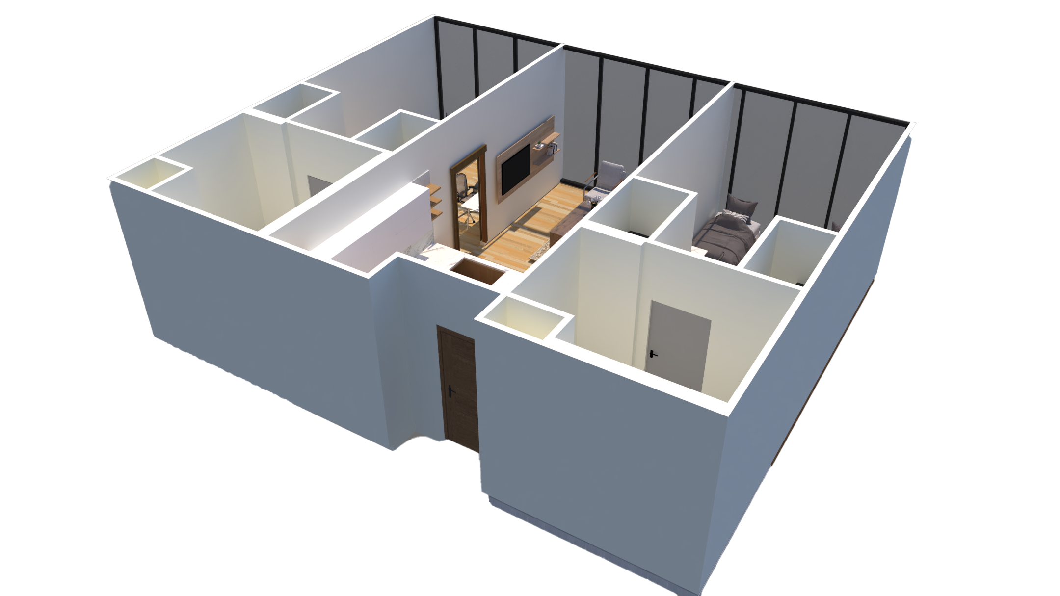
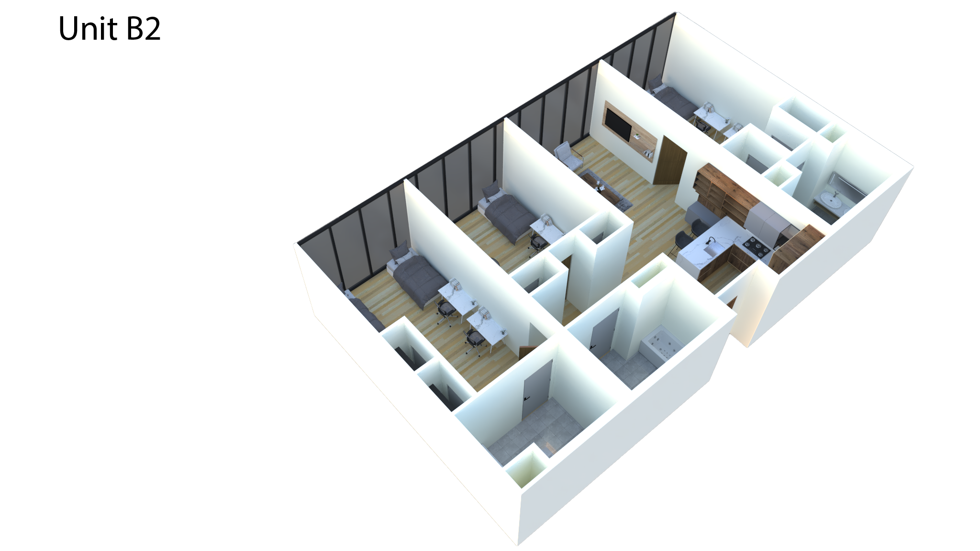
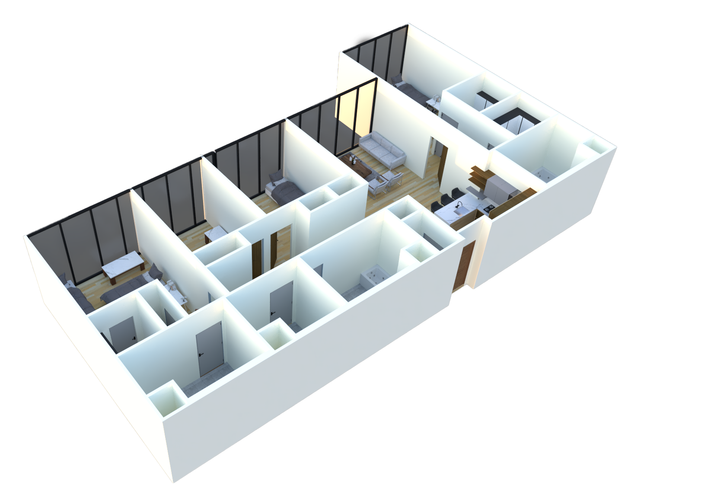
RENT COMPARABLE
2 BEDROOM UNITS
Site | The Grad | Student Housing
Unit (SF) | 923 | 917
Rent ($/Mo) | 4038 | 4516
Rent ($/Mo/SF) | 4.37 | 4.92
3 BEDROOM UNITS
Site | The Grad | Student Housing
Unit (SF) | 1209 | 1188
Rent ($/Mo) | 5397 | 5547
Rent ($/Mo/SF) | 4.46 | 4.67
4 BEDROOM UNITS
Site | The Grad | Student Housing
Unit (SF) | 1332 | 1745
Rent ($/Mo) | 5436 | 6996
Rent ($/Mo/SF) | 4.08 | 4.01

Slide 10
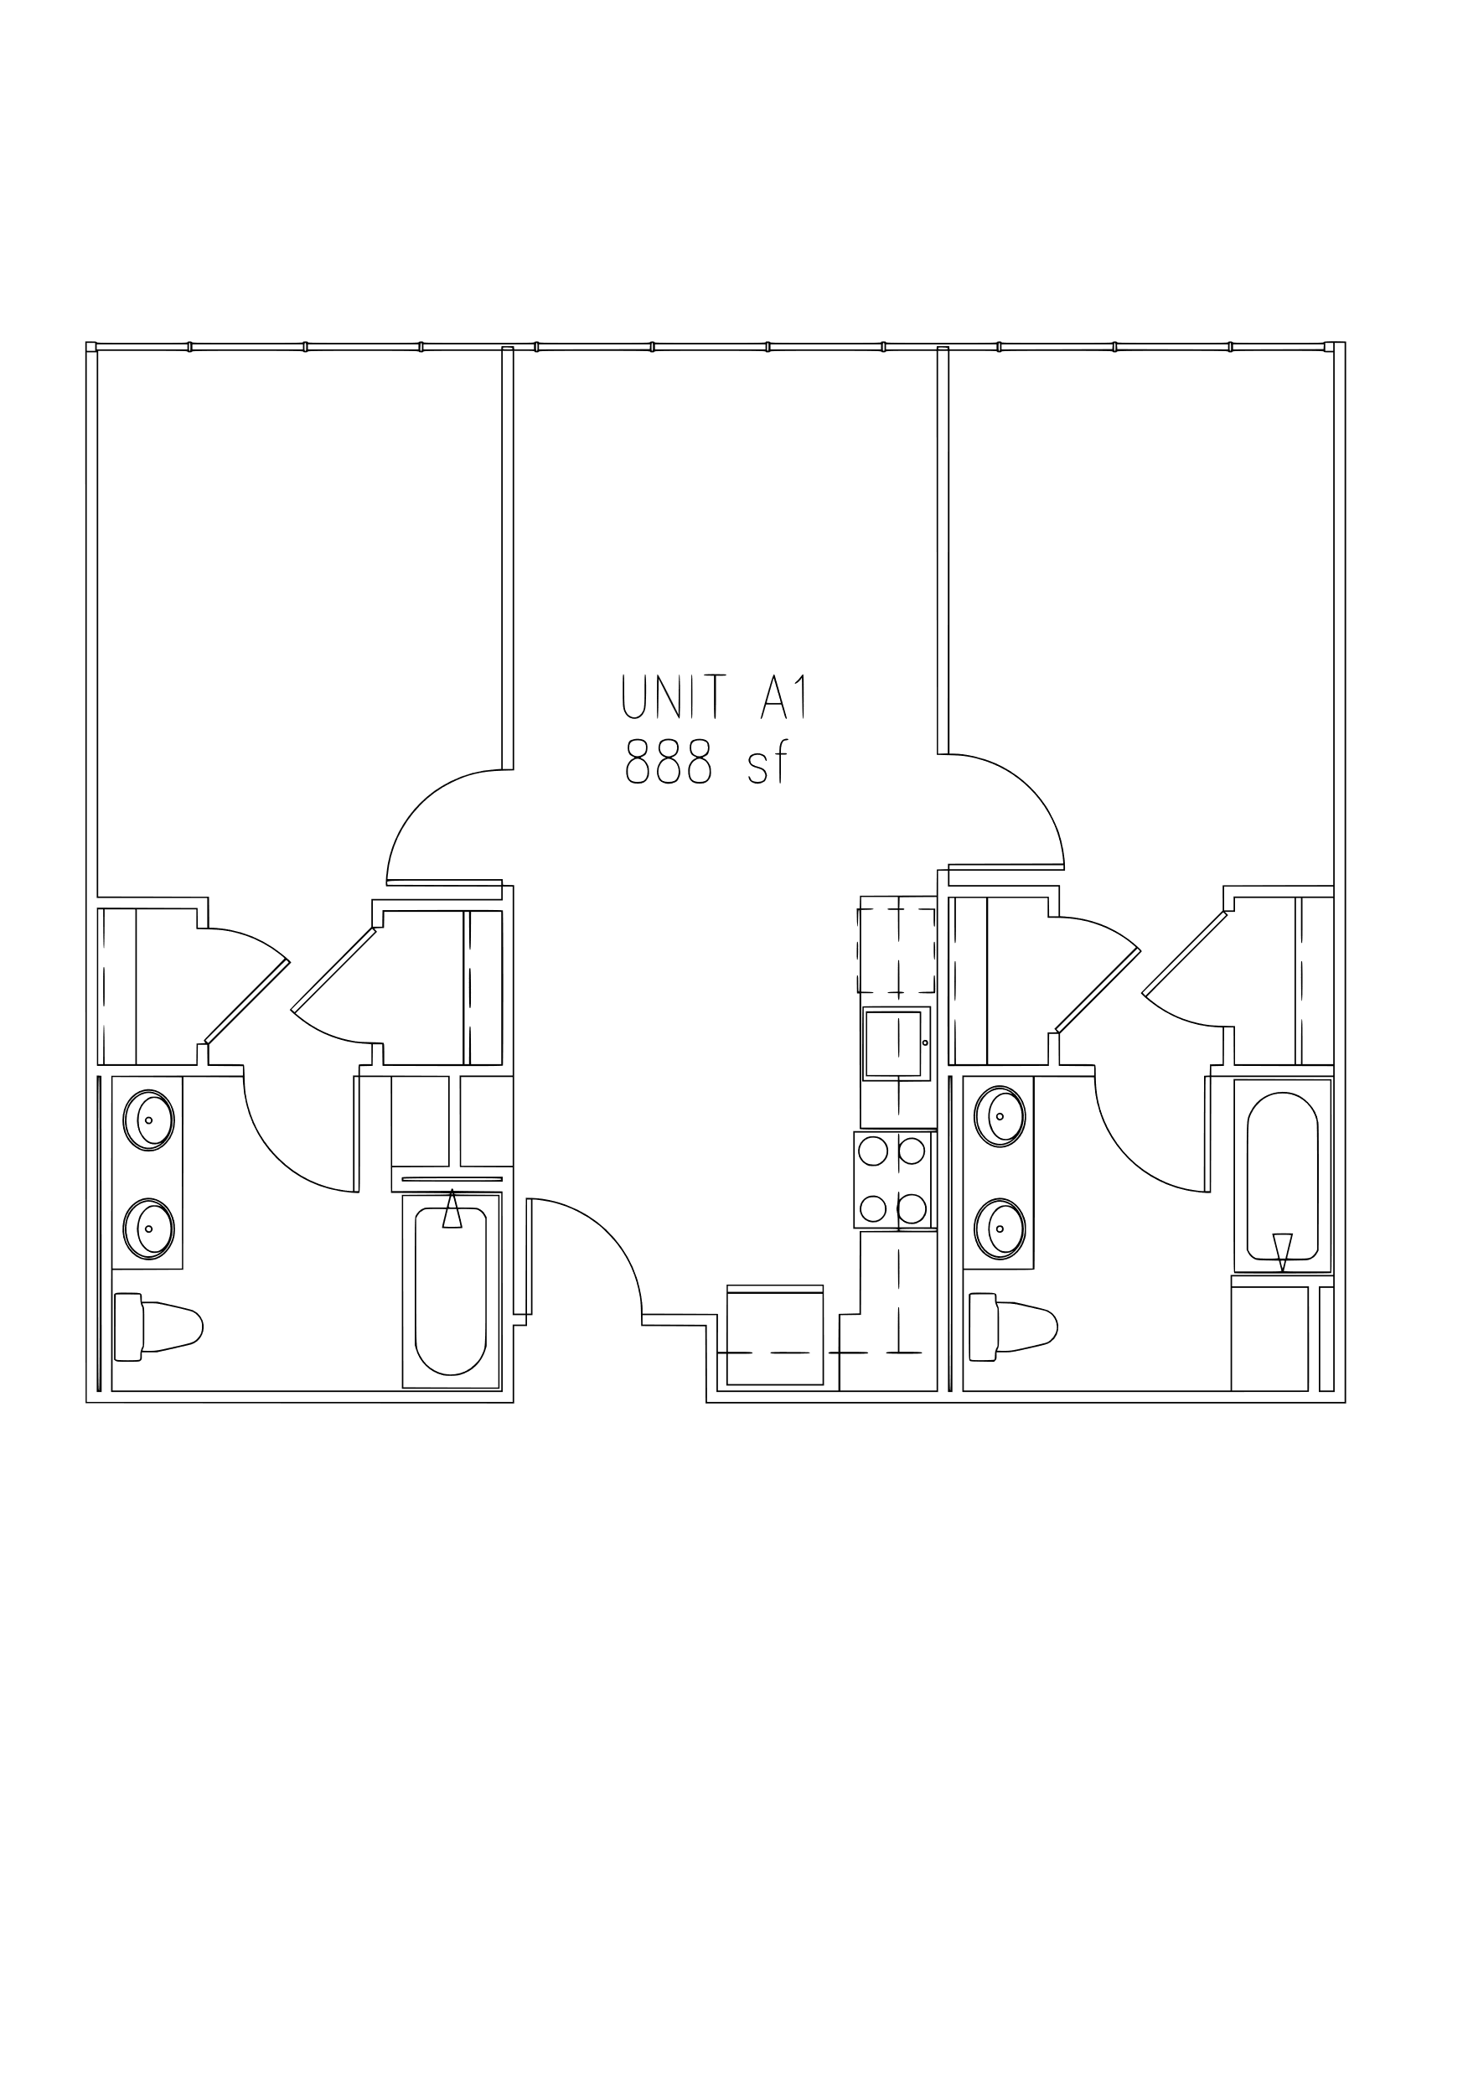

Slide 11
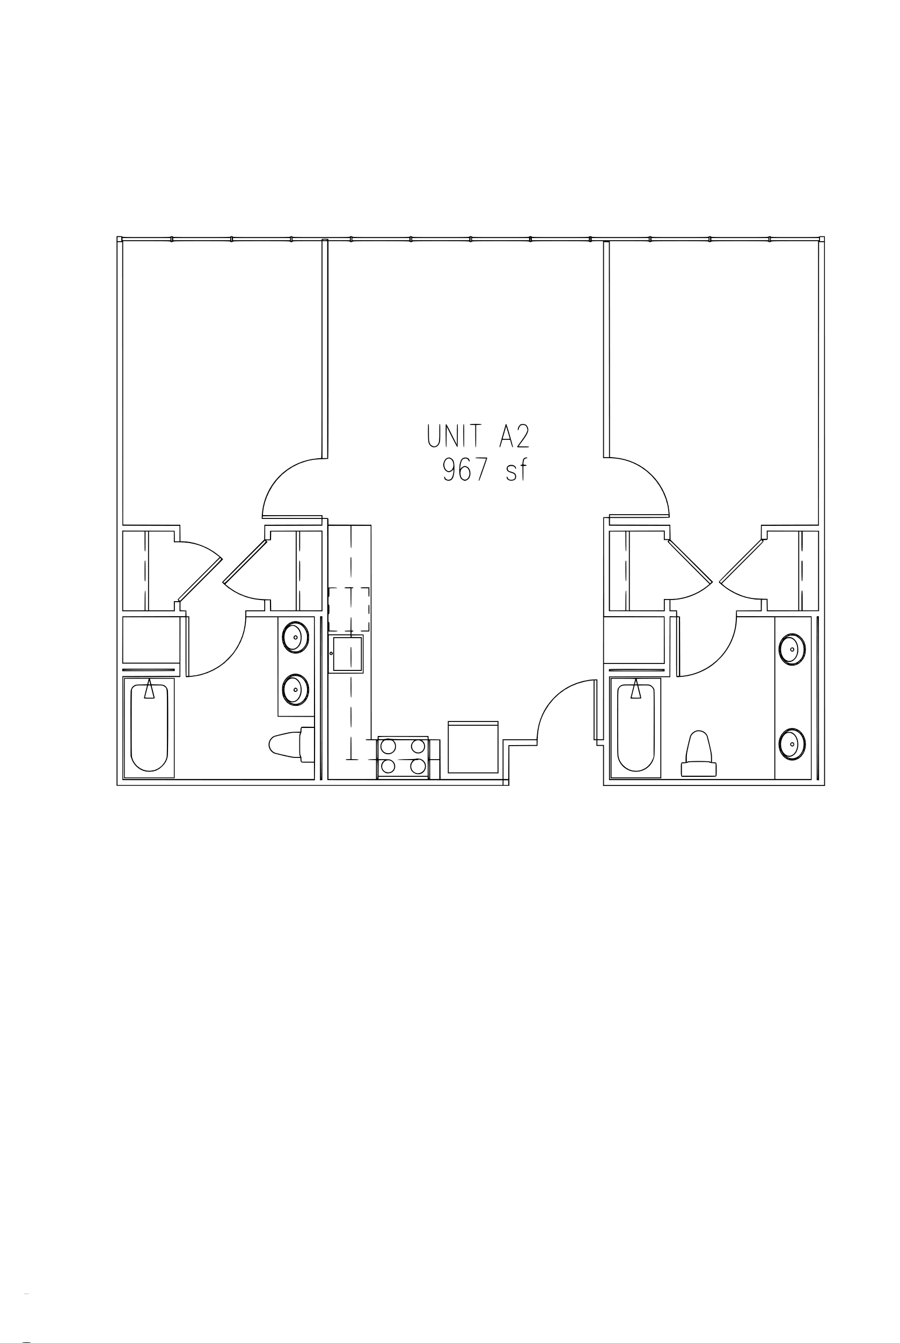

Slide 12
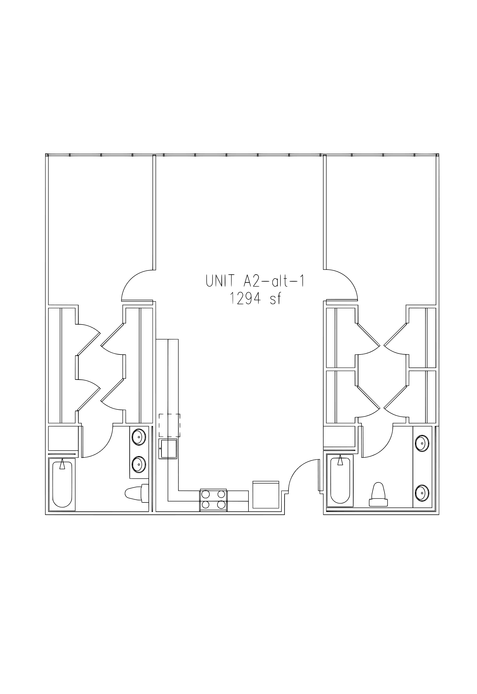

Slide 13
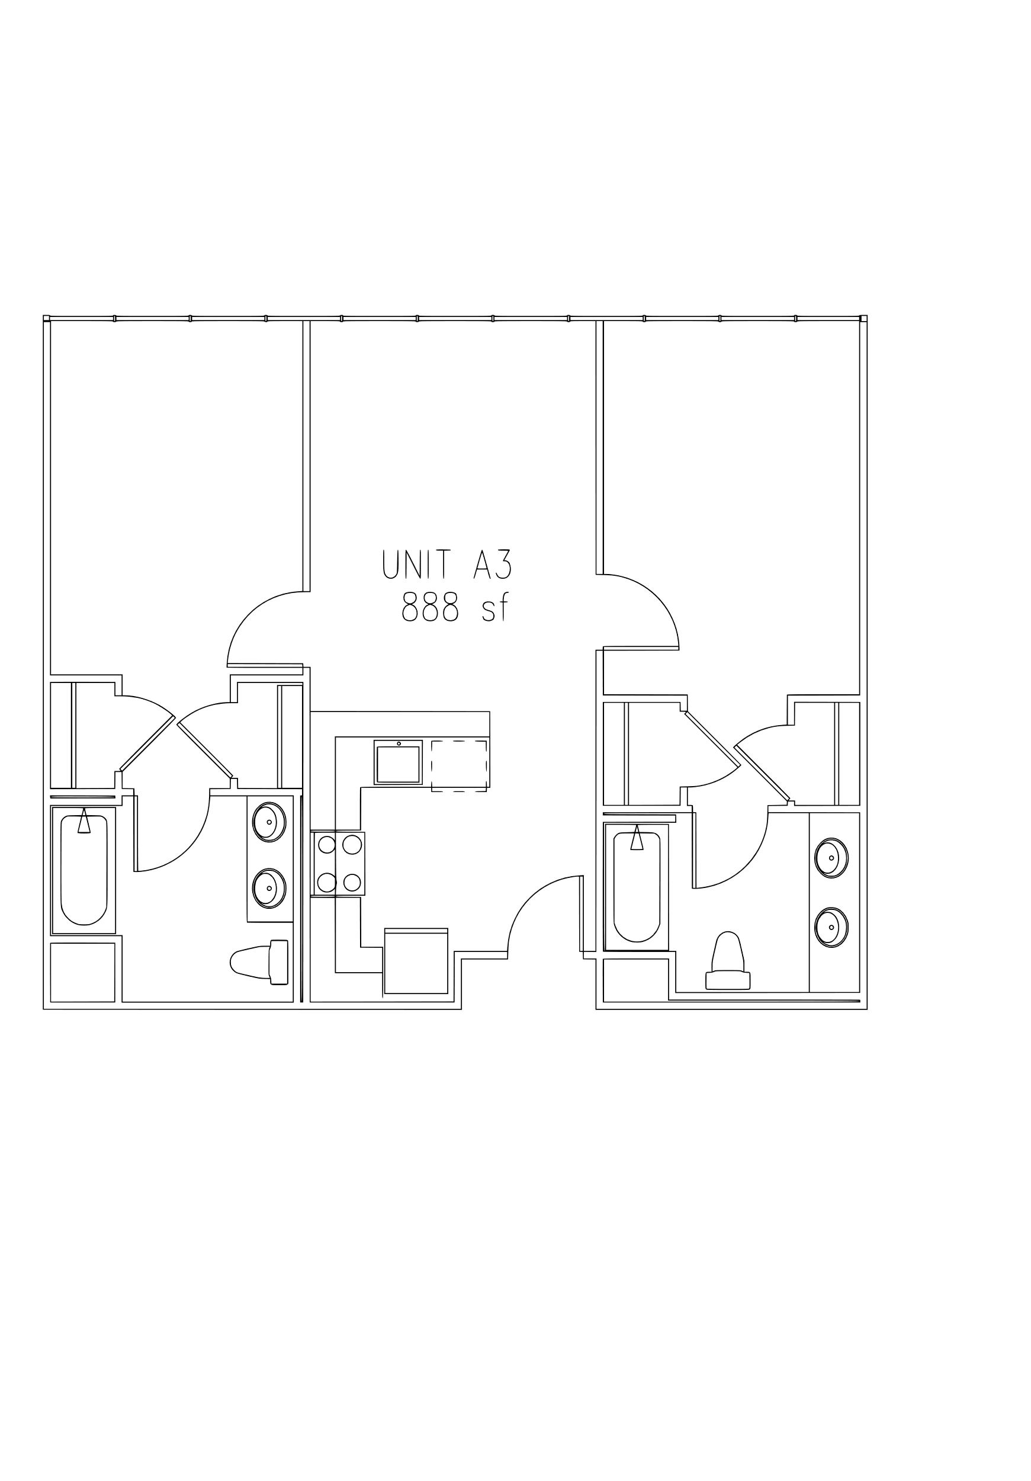

Slide 14
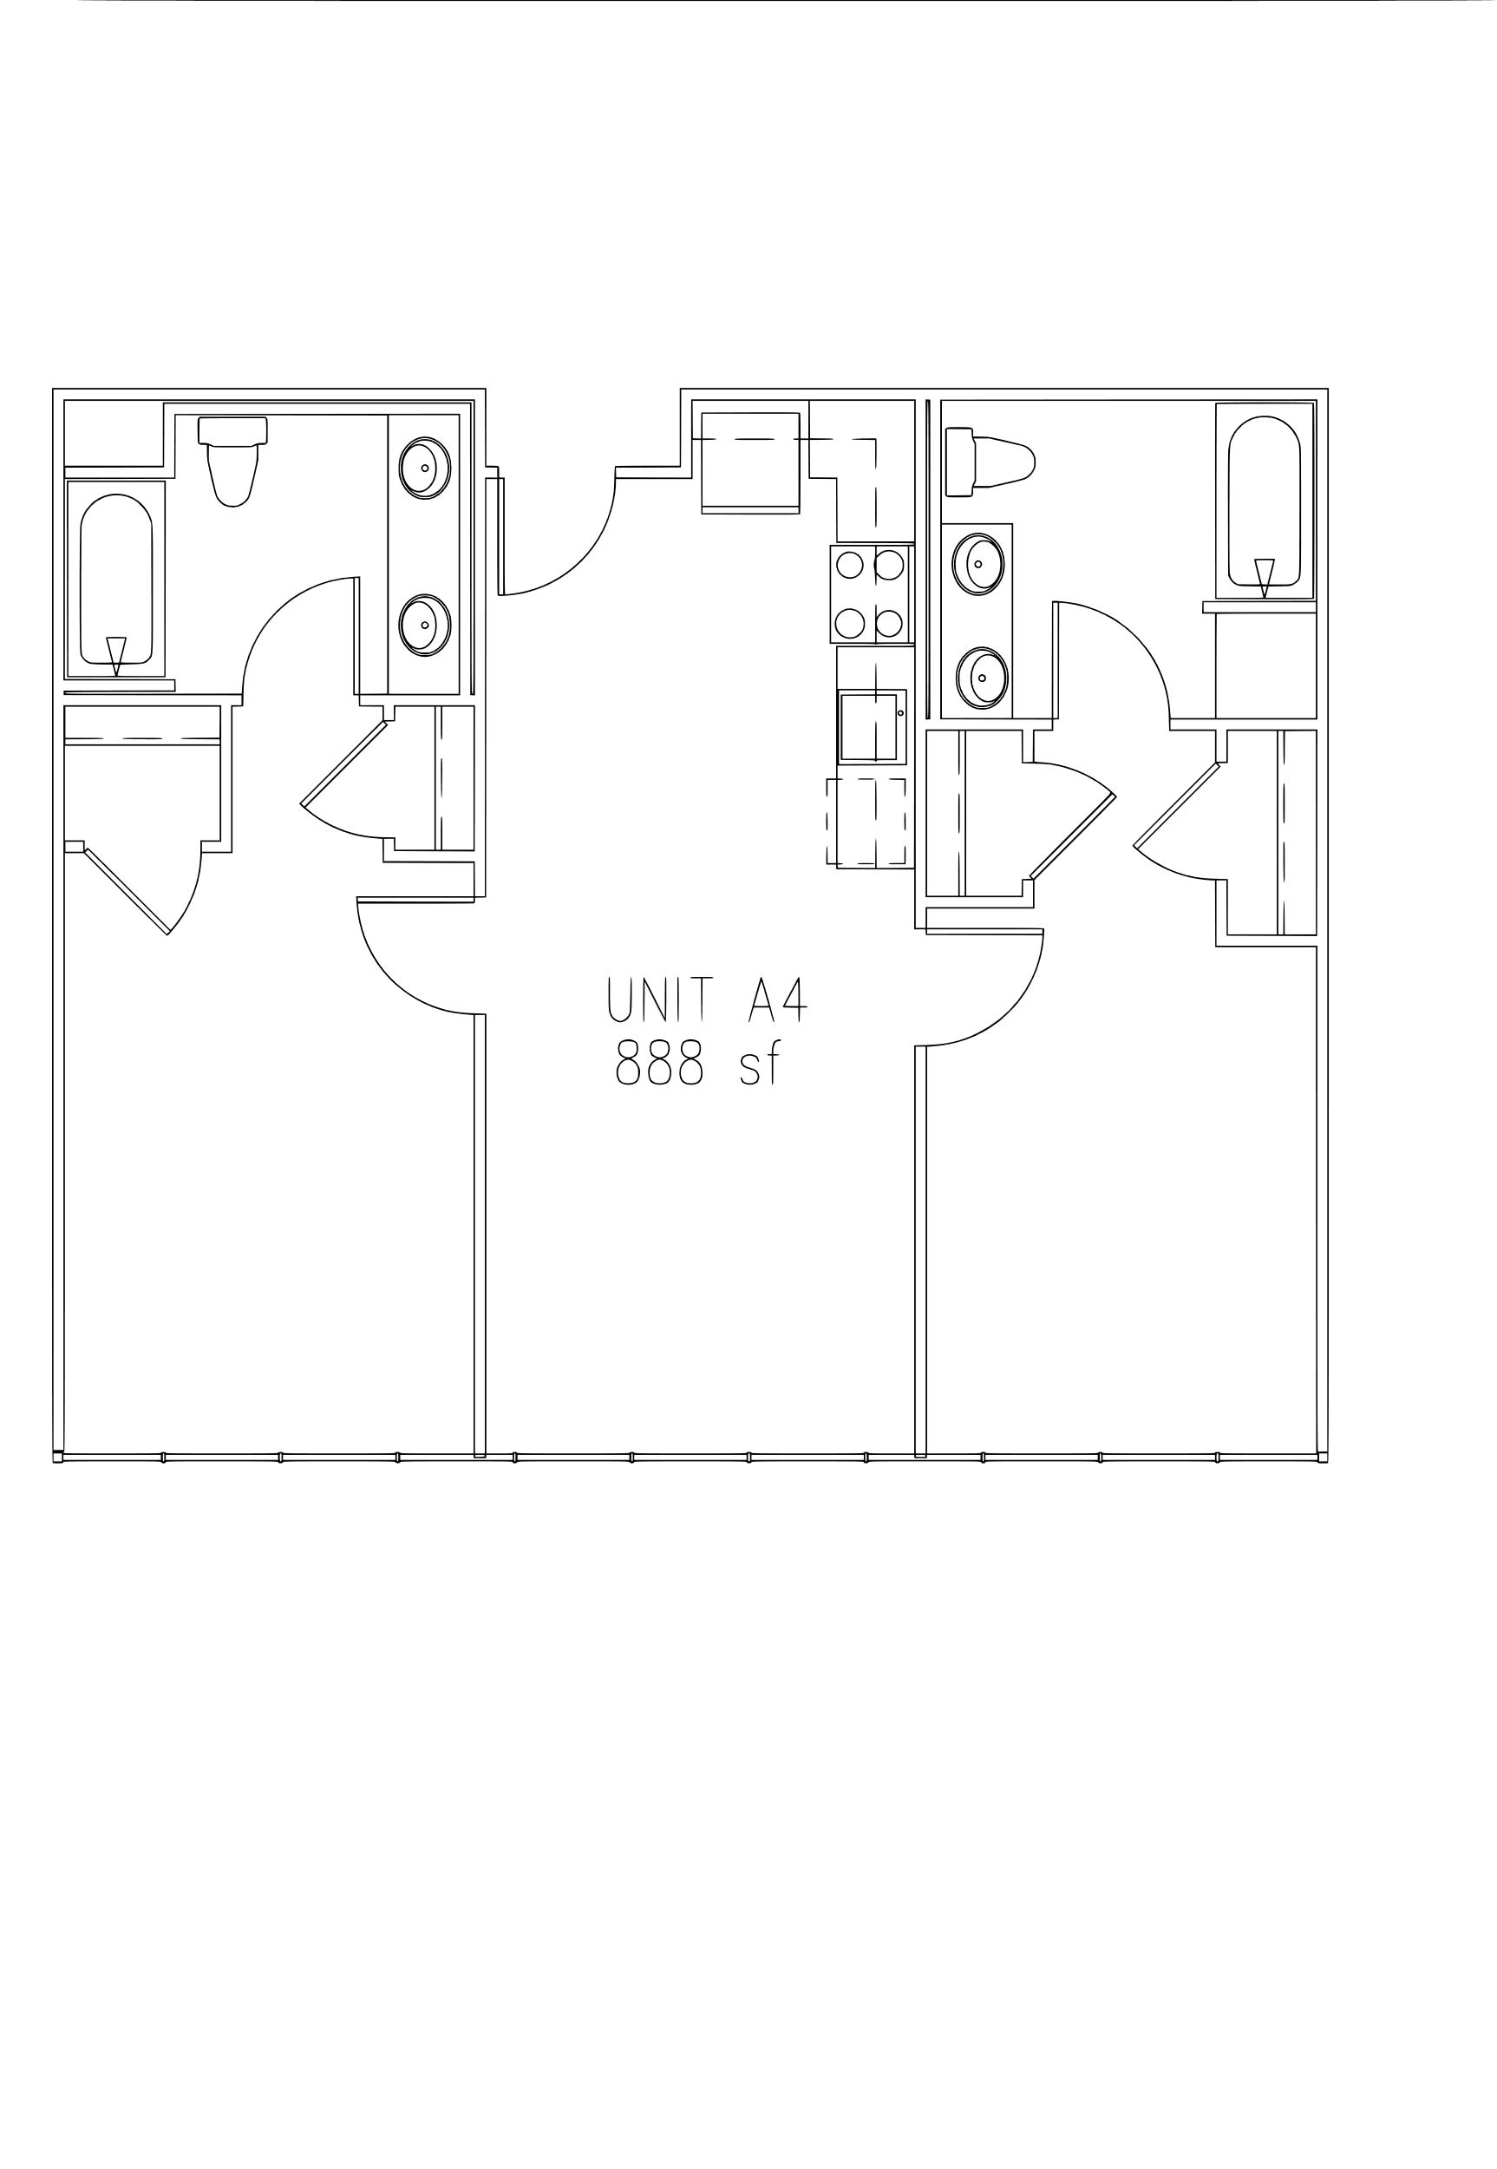

Slide 15
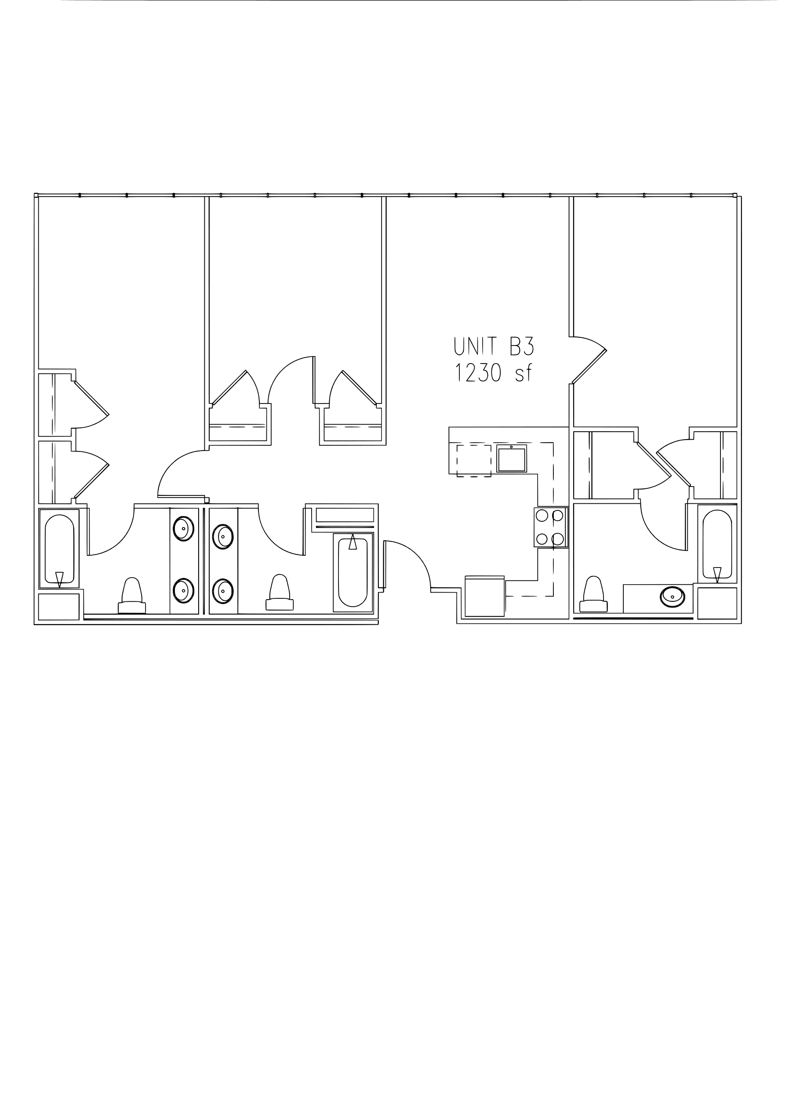

Slide 16
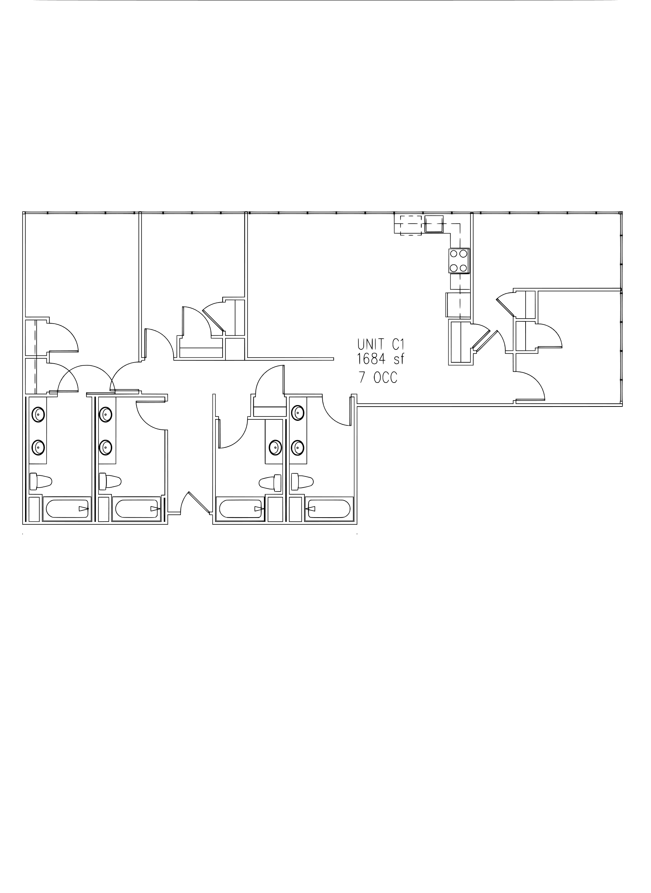

Slide 17
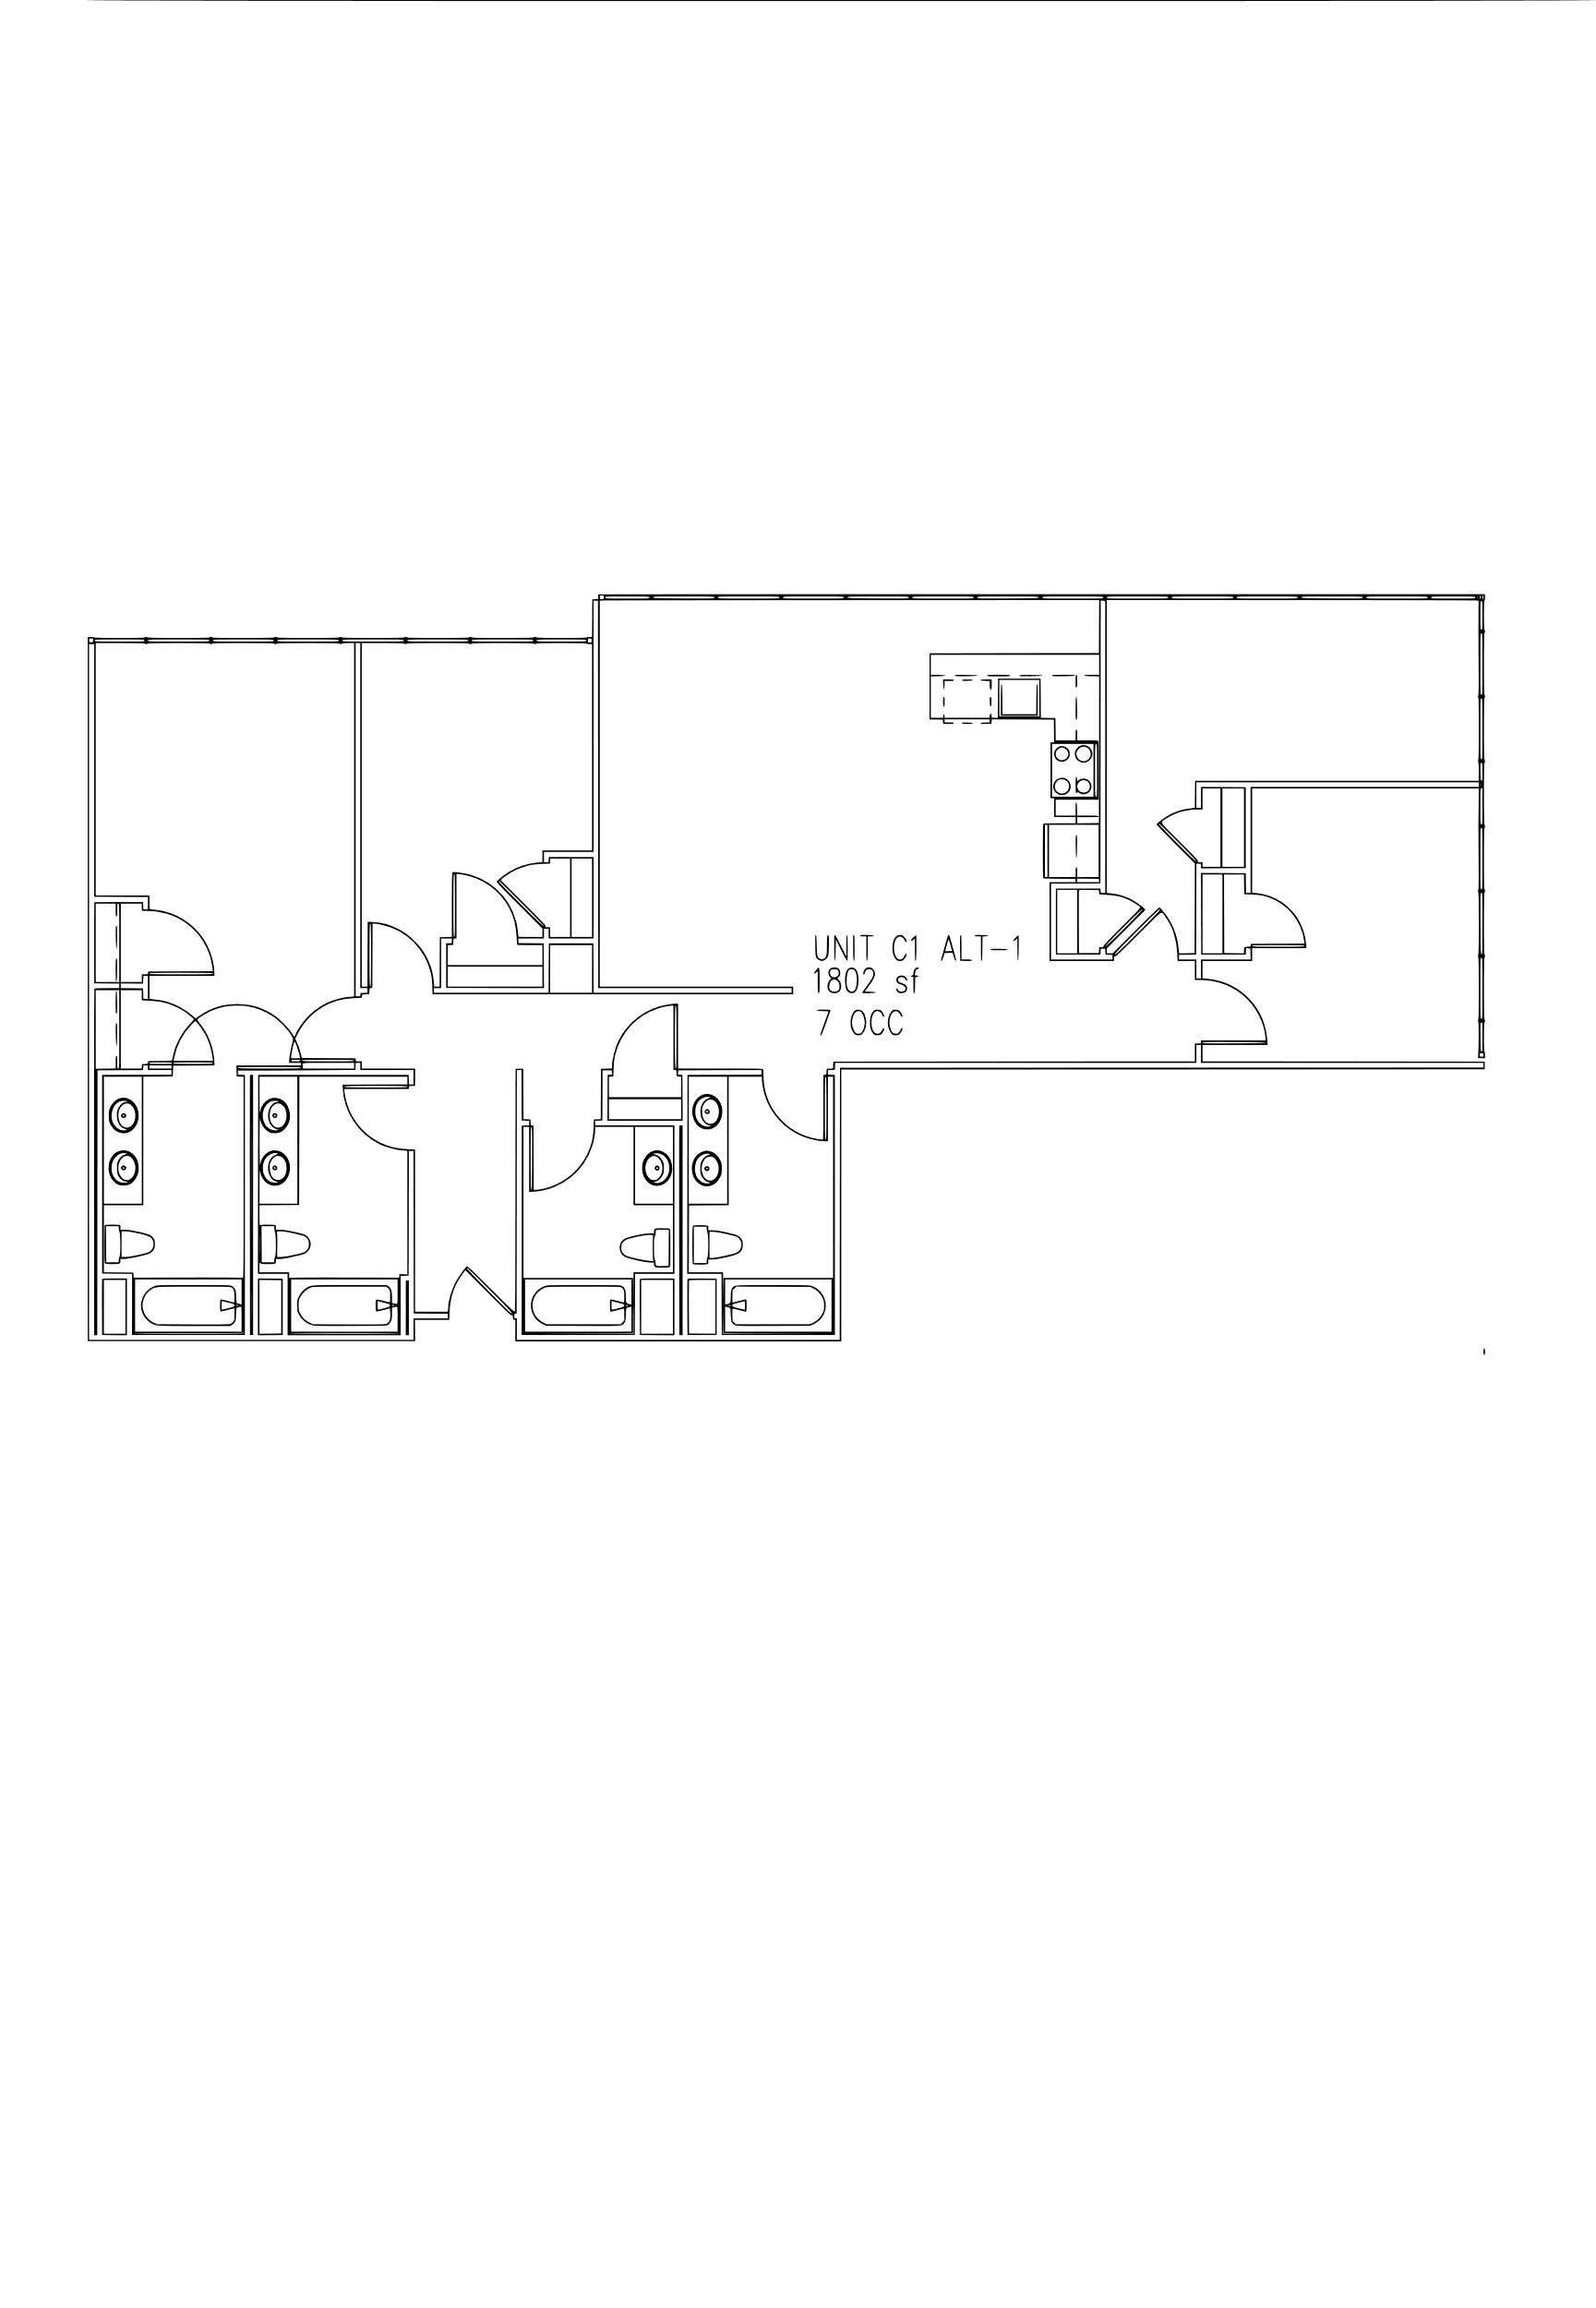

Slide 18
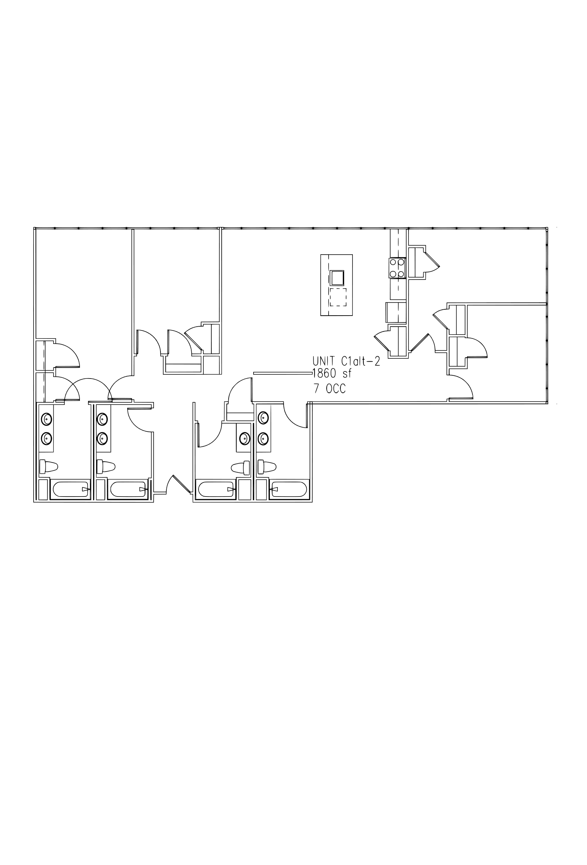

Slide 19
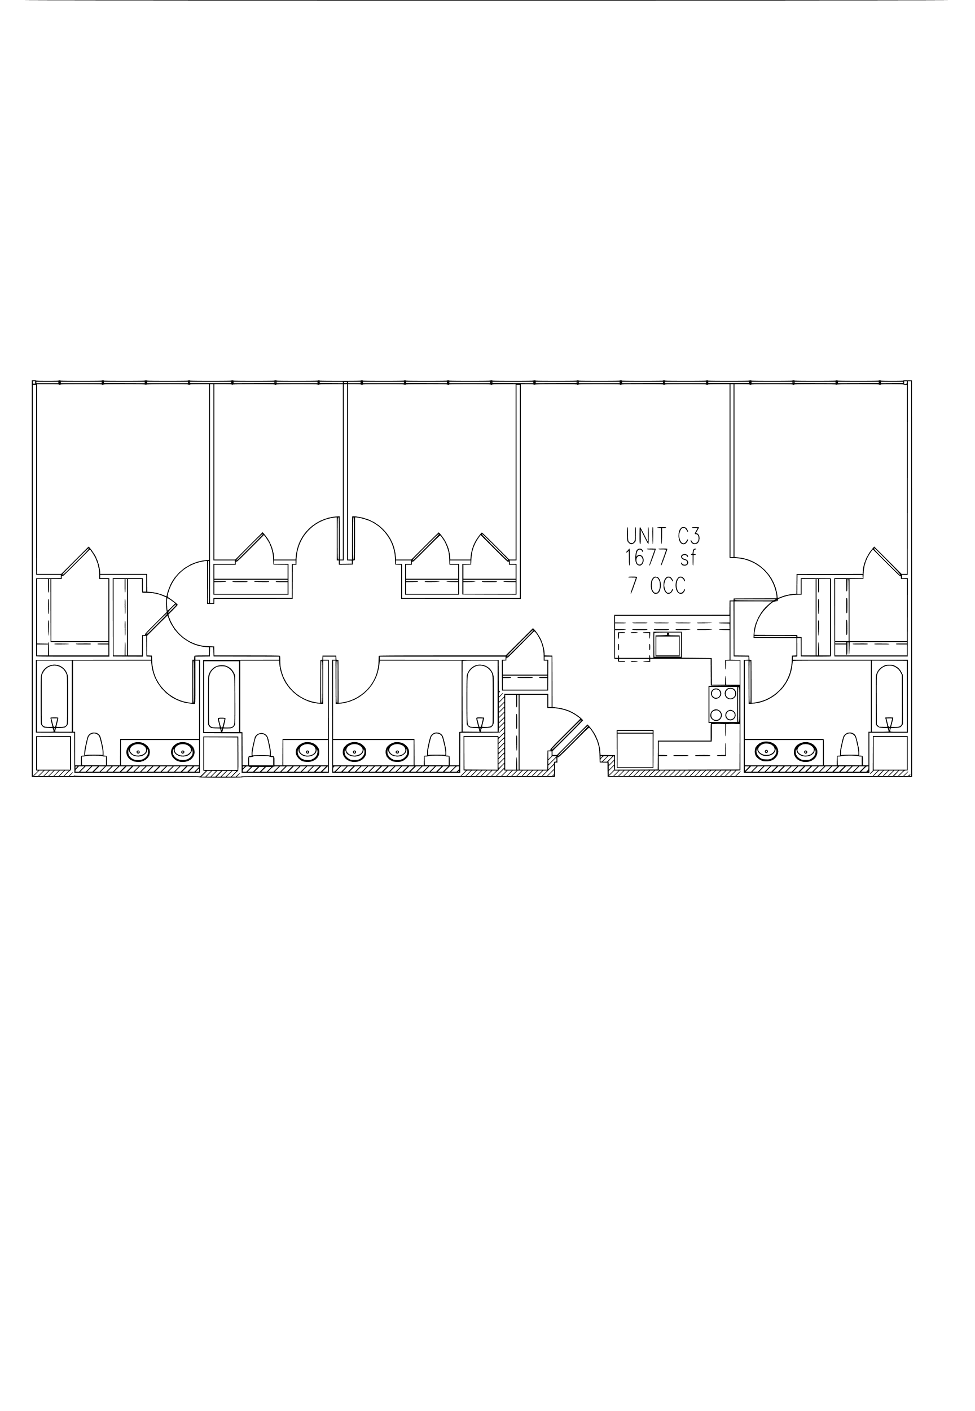

Slide 20
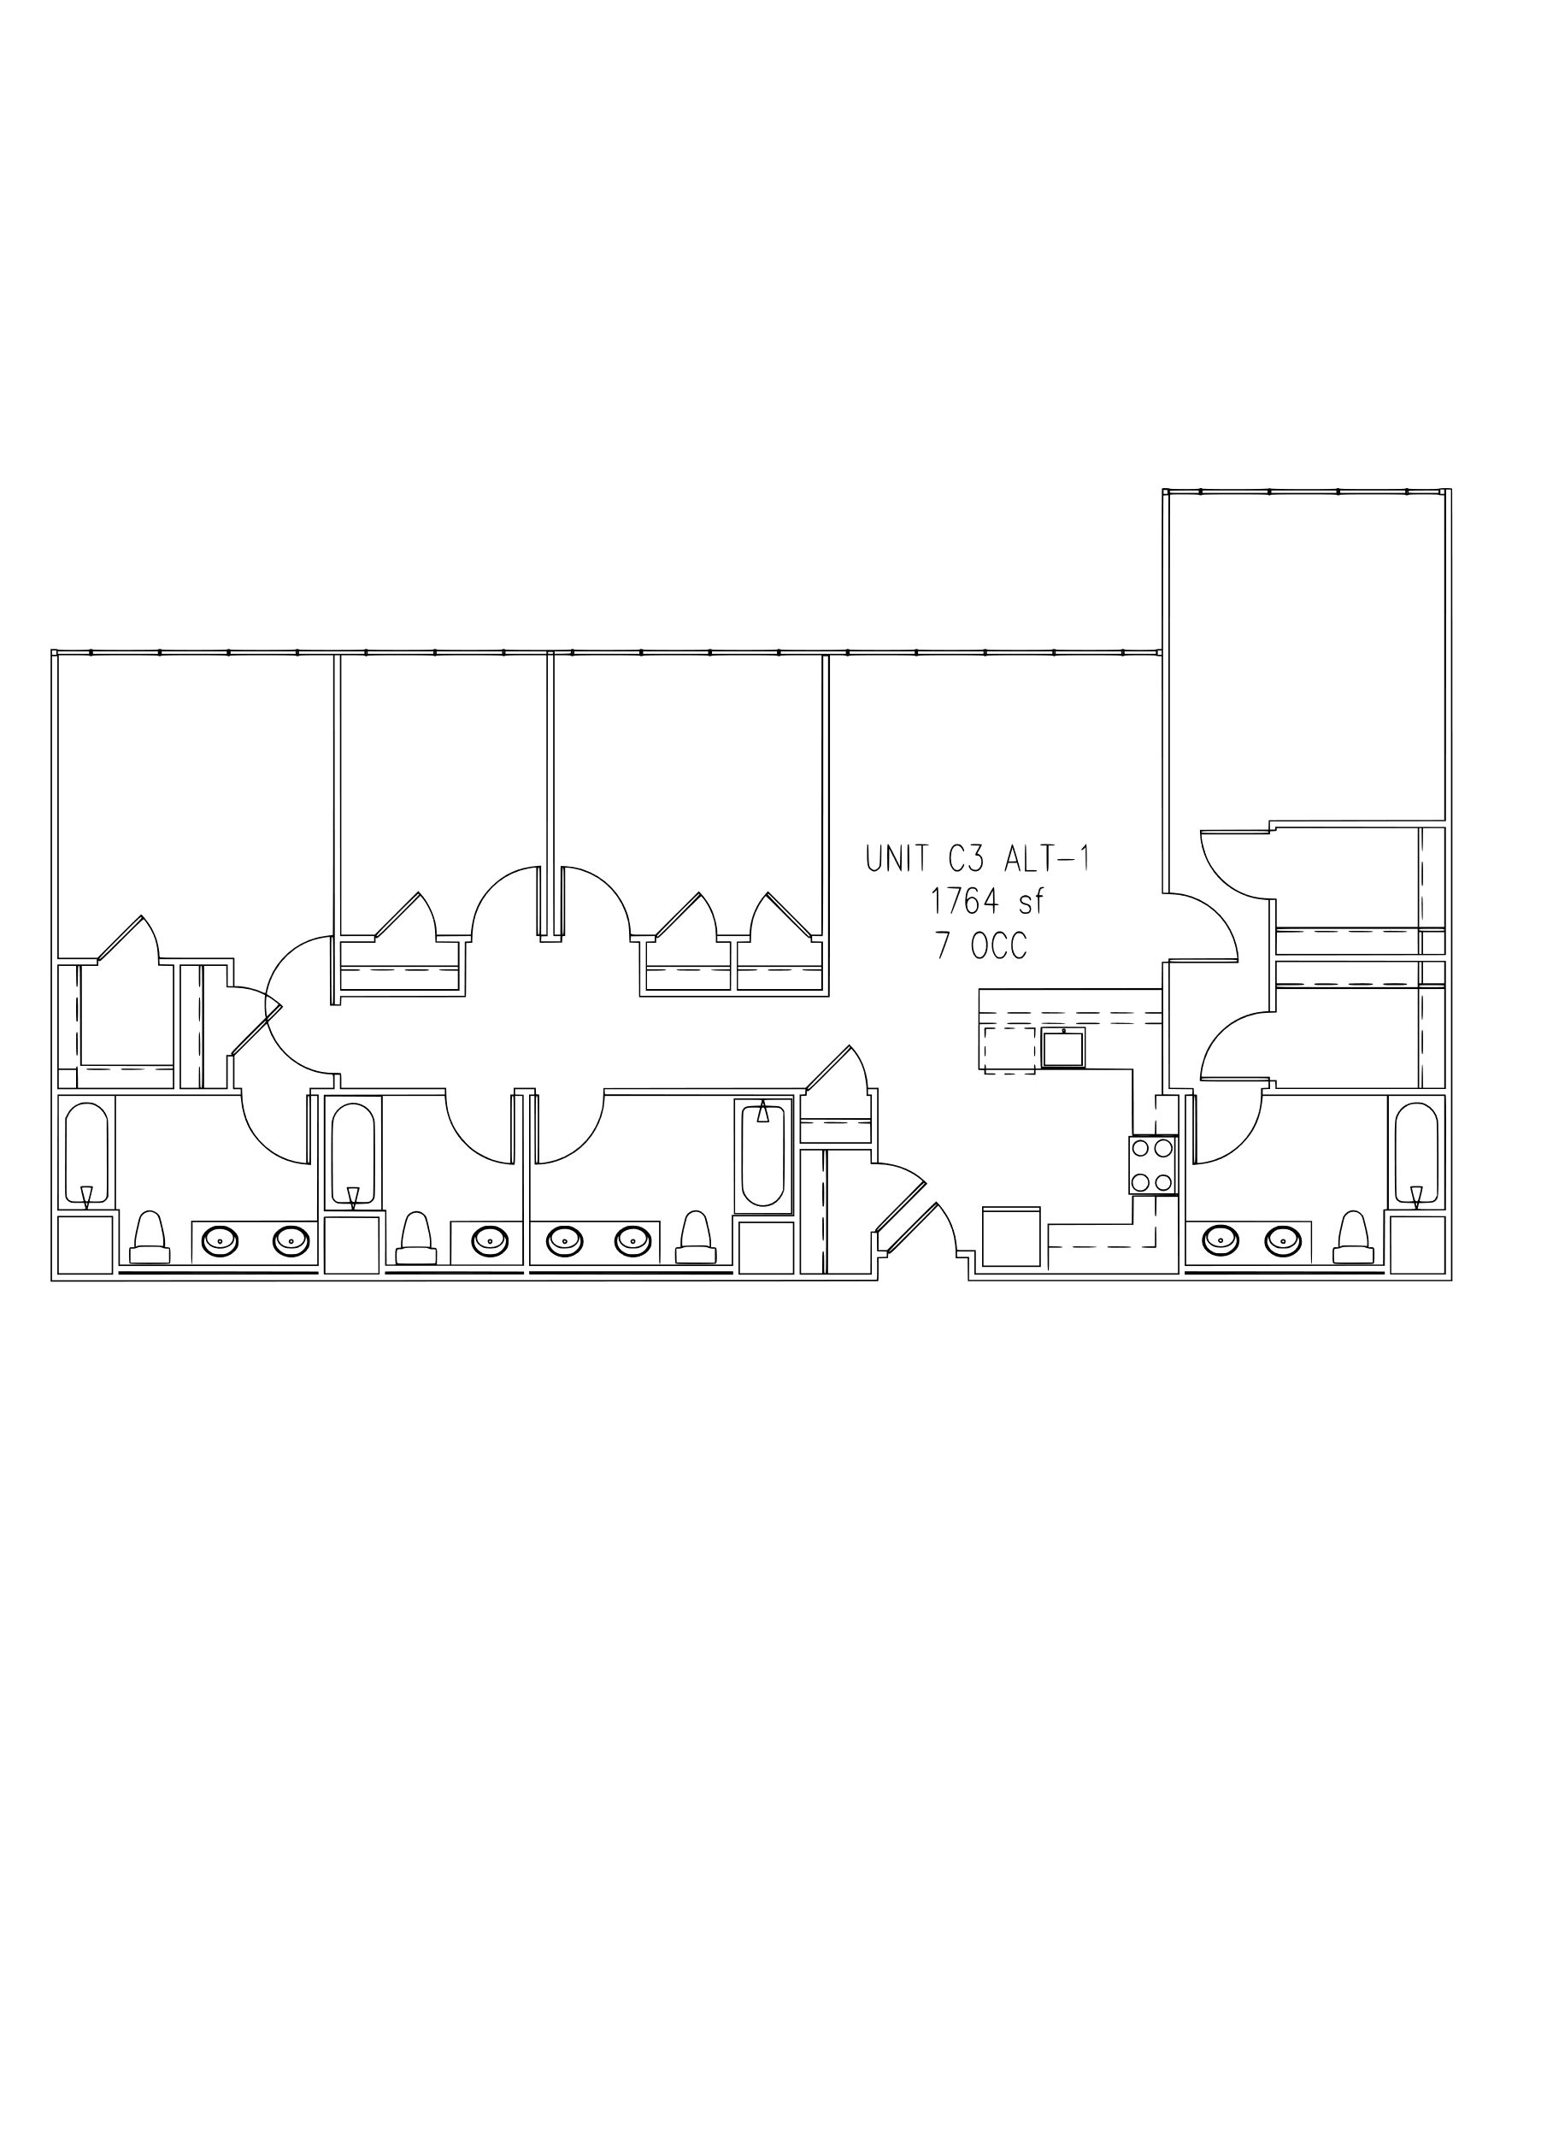

Slide 21
DEMOGRAPHIC
graduate or professional degree
bachelor's
high school degree

Slide 22
JOB OPPORTUNITIES
ADOBE
APPLE
ALPHABET
NVIDIA
NETFLEX
INTEL
META
EBAY
Cisco
google
PayPal
Verifone
Western Digital
SAGE INTACCT
CALYX SOFTWARE
AND MORE...

Slide 23
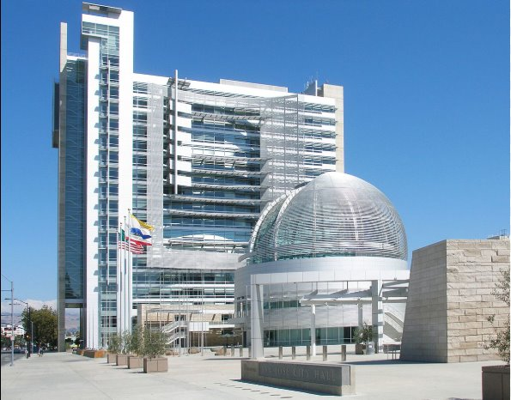
San Jose City Hall

Slide 24
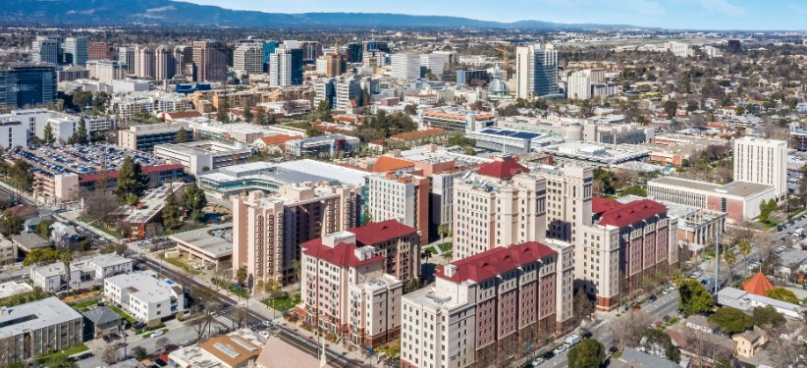
San Jose State University

Slide 25
CA DRE Lic. 02250937 Branden Lee CA DRE Lic. 02004029

